Slide 1
Project:
Microsoft : Classifying Cybersecurity Incidents with Machine Learning

Slide 2
Domain: Cybersecurity
Cybersecurity focuses on protecting systems, networks, and data from digital attacks, unauthorized access, and damage. It involves implementing measures like firewalls, encryption, and intrusion detection to ensure data integrity and confidentiality.

Slide 3
Project Introduction:
This project aims to enhance the operational efficiency of Security Operation Centers (SOCs) by developing a machine learning model that accurately classifies cybersecurity incidents as true positive, benign positive, or false positive. Using the GUIDE dataset, the model leverages historical incident data and customer responses to support automated triage, enabling SOC analysts to focus on critical threats and respond faster to potential security issues, ultimately strengthening enterprise security.

Slide 4
About classes in the target
True Positive: A correctly identified threat.
False Positive: An incorrectly identified threat (a false alarm).
Benign Positive: A legitimate activity that triggers a security alert.

Slide 5
Objective of the project:
Developed a machine learning model to classify cybersecurity incidents into true positive, benign positive, or false positive categories, enhancing SOC efficiency by automating triage grading. This solution aids SOCs, incident response automation, threat intelligence, and enterprise security by prioritizing threats, reducing false positives, and speeding up response times.

Slide 6
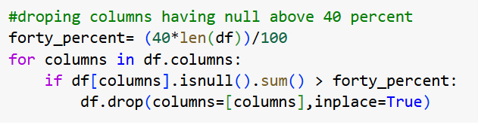
Data Preprocessing:
Removing the columns with null values above forty percentage will prevent biasing the prediction because imputing this will lead to that case.

Slide 7
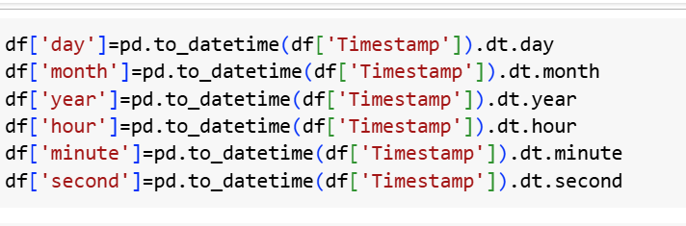
After removing those columns, the only left out is the target column “IncidentGrade”. So, the null values ‘IncidentGrade - 25775– 0.5%’ are dropped .
Next creating new columns from Timestamp columns to support the target prediction.

Slide 8
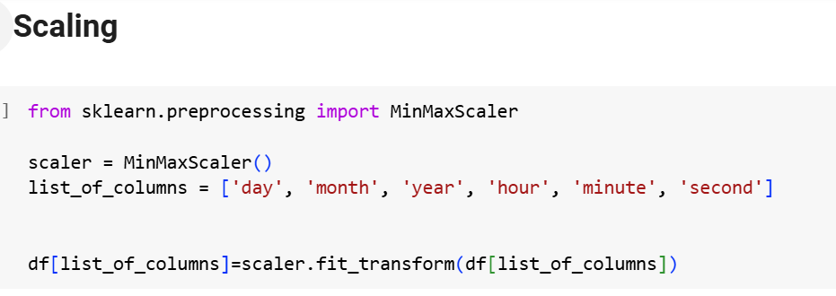

Slide 9
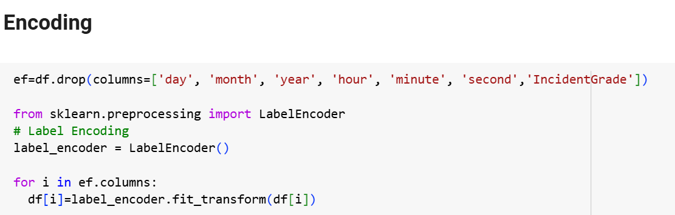

Slide 10
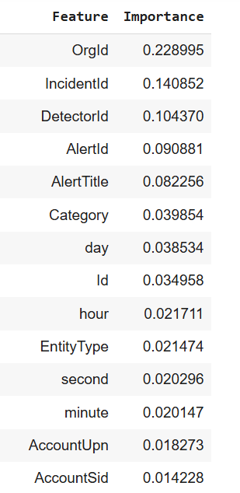
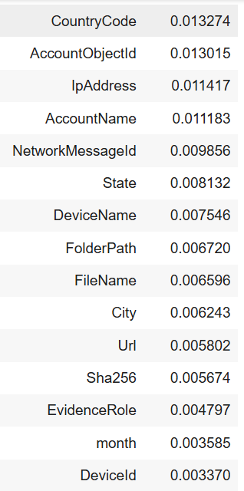
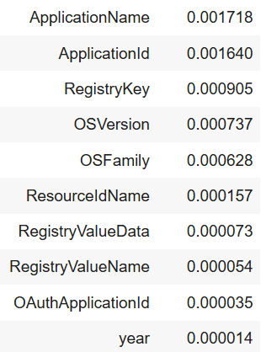
Feature Engineering:
Using random forest for feature engineering

Slide 11
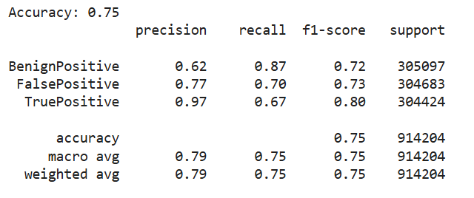
Since all the features are having importance including the created ones. Model building is done with all the columns.
Decision tree

Slide 12
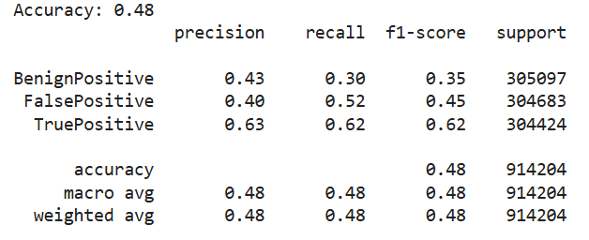
Logistic Regression

Slide 13
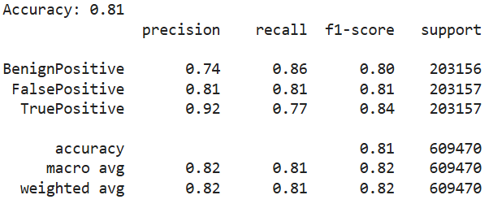
Gradient boosting
Even though accuracy here is same as random forest, the test accuracy is low

Slide 14
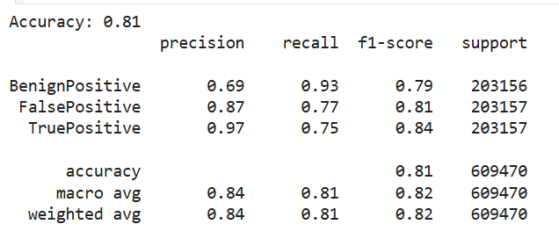
Random Forest

Slide 15
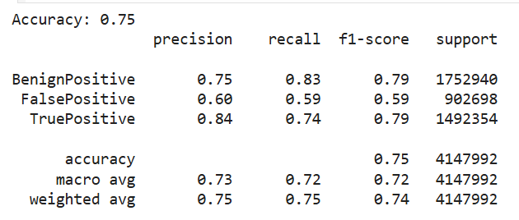
Random Forest Test
Since random forest gives best accuracy, it was chosen as the best model.

Slide 16
About the features selected:
OrgId: Identifier for the organization associated with the incident.
IncidentId: Unique identifier for the specific incident.
DetectorId: Identifier for the system or sensor detecting the alert.
AlertId: Unique identifier for the generated alert.
AlertTitle: Brief title describing the nature of the alert.
Category: Classification of the alert (e.g., Malware, Impact, etc.).

Slide 17
Recommendations:
Incident Triage Automation:
Use the model’s predictions to classify incidents into True Positive (TP), Benign Positive (BP), and False Positive (FP).
TPs: Route for immediate action.
BPs: Validate non-critical activity.
FPs: Suppress to reduce noise.

Slide 18
Integration with SOC Tools:
Deploy in Security Information and Event Management (SIEM) systems for real-time triage.
Enrich predictions with threat intelligence (e.g., IP reputation, historical patterns).
Feedback for Continuous Improvement:
Capture analyst overrides and retrain the model regularly to enhance accuracy.

Slide 19
Future Improvements
Improve Class Balance:
Address class imbalance using SMOTE or class-weighted methods to enhance FP performance.
Feature Enrichment:
Add temporal data, historical trends, and external threat intelligence for better context.
Advanced Models:
Experiment with Gradient Boosting (e.g., XGBoost) or Neural Networks for better accuracy on complex data.

Slide 20
Conclusion:
This model enables efficient incident triage, reduces false positives, and provides actionable insights for SOC analysts, improving overall security posture. Enhancements in data features, model robustness, and real-time capabilities will further optimize its performance.

